Slide 1


JavaScript
Discover the JavaScript Language

Slide 2

JavaScript
Course objectives
By completing this course, you will be able to:
Explain origins of JavaScript
Describe how it works
Explain its utility
Develop basic JavaScript procedures
Manipulate the DOM with JavaScript

Slide 3


JavaScript
Course topics
Course’s plan:
Presentation
Basics notions
Functions & Scope
Events
DOM Interactions
Object Modeling

Slide 4

Presentation
Discover JavaScript language

Slide 5

Introduction
Presentation
JavaScript is a scripting language
Design by Brendan Eich (Netscape) in 1995
Inspired by many languages, including Java and Python

Slide 6
Introduction
Presentation
At first, server side language called LiveScript
Then, client side version called JavaScript
Partnership between Sun Microsystems and Netscape about the name
"JavaScript” was a trademark of Sun Microsystems and now Oracle Corporation

Slide 7
Introduction
Presentation
Client side → Interpreted by web browser
Different from PHP
Complementary to HTML and CSS
Add dynamism!
User Interactions
Animations
Navigation Help

Slide 8
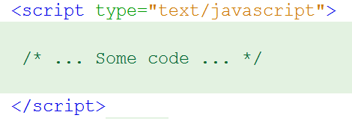

Introduction
Presentation
As CSS, JavaScript code can be defined in:
HTML code
a separate script file (.js)

Slide 9
Introduction
Presentation
Based on events:
onload
onfocus
onclick
ondblclick
Associated to DOM objects:
window, document, forms, ...
onabort
onerror
onmouseover
….

Slide 10
Introduction
Presentation
Not a classical OOP language
Prototype-based
No real concept of class
"Pseudo-classes" can be written like collections of key/value pairs
Includes most of class-based OOP features
Notes:
OOP = Object Oriented Programing

Slide 11
History
Introduction
First release of Netscape
JavaScript creation
Release of Netscape2 with JavaScript
ECMA produced the ECMAScript
Release of IE3 with JScript
(MS implem. of JS)
1994
1995
1996

Slide 12
History
Introduction
Release of JavaScript 1.1 and Netscape 3
Release of JavaScript 1.2
Release of Netscape 4
Release of Internet Explorer 5 with JavaScript 1.5
Appearance of the term: DHTML
1996
1997
1999

Slide 13
History
Introduction
JavaScript 1.5
First Mozilla release
JavaScript 1.6
JavaScript 1.8
JavaScript 1.7
JavaScript 1.8.5
2000
2002
2005
2006
2008
2010

Slide 14



Libraries
Introduction
Many libraries :
jQuery
Ext JS
Prototype
Dojo
Etc…

Slide 15
Community
Introduction

Slide 16
Community
Introduction
https://github.com/languages/JavaScript

Slide 17
JavaScript Everywhere
Introduction

Slide 18


Questions ?

Slide 19

Basic notions
Discover JavaScript language

Slide 20
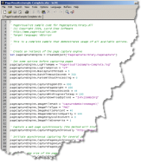
Hello World!
Basic notions
Hello world example:
<!DOCTYPE html>
<html>
<head>
<title>Hello World!</title>
</head>
<body>
<script type="text/javascript">
alert('Hello world!');
</script>
</body>
</html>

Slide 21
Implementation of JavaScript code
Basic notions
Two places to declare JavaScript code:
In HTML file directly between <script> markers:
In an external script file:
<script type="text/javaScript"> var name = "Grima"; </script>
<script type="text/javaScript" src="script.js"></script>

Slide 22
Syntax rules and basics
Basic notions
An instruction ends up properly with a semicolon:
Possible to put on the same line several instructions
<script type="text/javaScript">
Instruction_1;
Instruction_2; Instruction_3;
</script>

Slide 23
Syntax rules and basics
Basic notions
We create a single line comment with //, multi-lines between /* and */
<script type="text/javascript">
// Single line comment
/* Multi
line
comment */
</script>

Slide 24
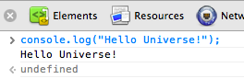
Syntax rules and basics
Basic notions
To display text on the console:
console.log()
<script type="text/javascript">
// Displays Hello Universe!
console.log("Hello Universe!");
</script>

Slide 25
Syntax rules and basics
Basic notions
To display text on a web page:
document.write()
<script type="text/javascript">
// Add « Hello World! » inside the page
document.write("Hello World!");
</script>

Slide 26
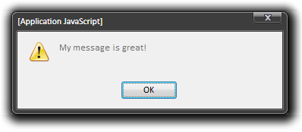
Syntax rules and basics
Basic notions
To display a message through a dialog box:
window.alert(message)
window.alert("My message is great!");
// Also works
alert("My message is great!");
Notes:
https://developer.mozilla.org/en/nsIPromptService

Slide 27
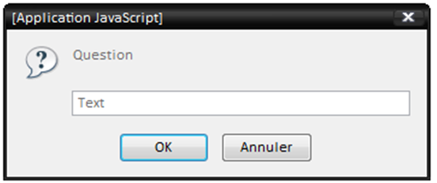
Syntax rules and basics
Basic notions
To get a value with a prompting box:
window.prompt(text, default_value)
var returnValue = window.prompt("Question", "Text");
// Also works
returnValue = prompt("Question", "Text");
Notes:
https://developer.mozilla.org/en/nsIPromptService

Slide 28

Variables
Basic notions
Case sensitive:
myvariable ≠ myVariable
We assign a value to a variable by setting its name on the left of the assignment operator
( = ), and the value on the right

Slide 29
Variables
Basic notions
Explicit declaration with var keyword
A variable's name:
Can not begin by a number
Must contain only alphanumerical characters.
Can not be a reserved word (var, for…)
<script type="text/javascript">
var name = "Estelle";
</script>

Slide 30
Variables
Basic notions
Implicit declaration without var
<script type="text/javascript">
name = "Doug";
</script>

Slide 31
Variables
Basic notions
Concatenation: Combine string value(s) with other types
Operator +
var max_age = 18;
var message = "Not allowed under " + max_age + " years old";

Slide 32
Variables
Basic notions
Weak typing
Type of a variable defines format of its content
Obtain type of a variable: typeof
var myVar1 = "I am a string !";
var myVar2 = "I am really a string ?";
myVar2 = 100;
document.write(typeof myVar1); // Will display "string"
document.write(typeof myVar2); // Will display "number"
Notes:
C use strong typing !

Slide 33
Operators
Basic notions
Mathematic operators:
Symbol | Example | Explanation
= | var salary = 2800; | Affectation
+ | salary = salary + 2800 | Operation or Concatenation
- | salary = salary – 2800 | Substraction
* | salary = salary * 2800 | Multiplication
/ | salary = salary / 2800 | Division
% | salary = salary % 2800 | Modulo

Slide 34
Operators
Basic notions
Comparison operators:
(given salary = 2800)
Symbol | Example | Returns | Explanation
== | salary == 2800 salary == "2800" | true true | Equals
=== | salary === "2800" salary === 2800 | false true | Exactly equals (value and type)
!= | salary != 2800 | false | Not equals
!== | salary !== "2800" | true | Not exactly equals (value and type)
> | salary > 2800 | false | Greater than
>= | salary >= 2800 | true | Greater than or equals
<= | salary <= 2800 | true | Lower than or equals
< | salary < 2800 | false | Lower than

Slide 35
Operators
Basic notions
Logic operators:
Symbol | Example | Explanation
&& | age == 18 && salary > 2800 | AND
|| | age == 18 || salary > 2800 | OR
^ | age == 18 ^ salary > 2800 | Exclusive OR
>> | salary >> age | Bitwise shift right
<< | salary << age | Bitwise shift left

Slide 36
Operators
Basic notions
Misc operators:
Symbol | Example | Explanation
+= | age += 18; | Addition (number) or concatenation (string)
new | var array = new Array(); | Object instanciation
delete | delete array; | Object destruction

Slide 37
Conditional statements
Basic notions
Conditional test: if … else if … else
if( expression1 ) {
// If "expression1" is evaluated to true, then this
// block is executed
} else if ( expression2 ) {
// Otherwise, if "expression2" is evaluated to true,
// this block is executed
} else {
// Otherwise, this code block is executed
}

Slide 38
Conditional statements
Basic notions
Case test: switch
switch(myVar) {
case "case1":
// if(myVar === "case1")
break;
case "case2":
// if(myVar === "case2")
break;
default:
// else - Default code to execute
break;
}

Slide 39
Arrays
Basic notions
Contain several data sequences
Many ways to create an array:
By creating an Array object
By using square-brackets [] (adviced)
Support all JavaScript data types

Slide 40
Arrays
Basic notions
Creation of Arrays
var fruitBasket1 = new Array("Apples", "Bananas", "Pears");
var fruitBasket2 = [ "Oranges", "Bananas", "Strawberries"];
var fruitBasket3 = [];
var apple = fruitBasket1[0];
fruitBasket3.push(apple);

Slide 41
Loops
Basic notions
Conditional loop: while
// It loops 40 times
var myVariable = 40;
while( myVariable > 0 ) {
myVariable = myVariable – 1;
}

Slide 42
Loops
Basic notions
Conditional loop: do … while
Same as while
First test after the first execution of loop’s block
var myVariable = 0;
// Loop will execute once even if the test returns false
do {
myVariable -= 1;
} while (myVariable > 0);

Slide 43
Loops
Basic notions
Iterative loop: for
Specify (or not):
Initial state
Iteration condition
Iteration instruction
var a;
for (a = 0; a < 100; a += 1){
// Loop will display Blabla 100 times.
document.write("<p>Blabla</p>");
}

Slide 44
Loops
Basic notions
Execute an operation once per array element:
The current element is represented by the param of the anonymous function
var myArray = ["Apple", "Strawberry"];
myArray.forEach( function(element) {
console.log(element + "/");
});
Notes:
We’ll see more about anonymous functions later…

Slide 45
Questions ?

Slide 46
Exercise (1/3)
Basic notions
You’re going to design your first JavaScript app:
A Guess the Number Game!
Initialize a variable named numberToFind with a random number between 0 and 100
Initialize another variable named remainingAttempts with the integer value 7

Slide 47
Exercise (2/3)
Basic notions
Until the user doesn’t find the numberToFind value and has remaining attempt, ask him to choose a number
If the number is the numberToFind value
Display a popup to the user to notify him he won
If the number is not the numberToFind value
Display a popup to the user to notify him if the number to find is greater or not

Slide 48
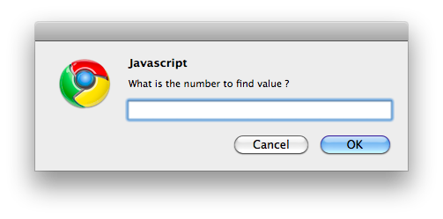
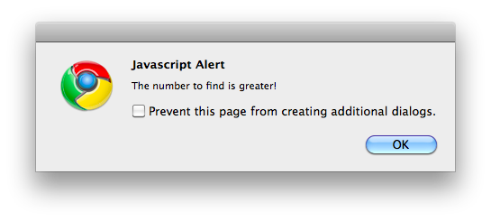
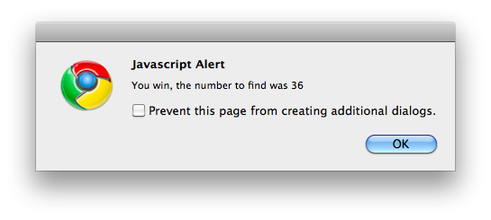
Exercise (3/3)
Basic notions

Slide 49

Functions & scope
Discover JavaScript language

Slide 50
Functions
Functions & Scope
Instruction unit
Declared with function keyword
Can take values or references called arguments
function myFunction(myParam1, myParam2) {
// Some code to execute
}

Slide 51
Functions
Functions & Scope
Called with its name followed by brackets:
functionName();
functionName(arguments);
Can send back a value with return keyword
Returned value can be use by the caller

Slide 52
Functions
Functions & Scope
Example:
function howOld(year){
var currentYear = new Date().getFullYear();
return currentYear - year;
}
// someValue will contain 22 (if current year is 2012)
var someValue = howOld(1990);
// Will display Bryan is 42 years old (if 2012)
console.log("Bryan is " + howOld(1970) + " years old");

Slide 53
Variable scope
Functions & Scope
Local:
Reachable only in the function where it's defined
Global:
Reachable in the whole document
function = scope
Explicit declaration inside function = local variable
Implicit declaration = global variable

Slide 54
Variable scope
Functions & Scope
Variables declared with var keyword inside a function are local variables of the function
Otherwise, without var keyword, they are considered as global variables
Declared variable outside function are also global variables

Slide 55
var myVar = "I am global\n";
function writeGlobal(){
console.log(myVar);
}
function setGlobal_writeLocal(newValue){
myVar = newValue;
var myVar = "I am local\n";
console.log(myVar);
}
writeGlobal();
setGlobal_writeLocal("I am still global\n");
writeGlobal();
// What display the console ?
Quizz

Slide 56
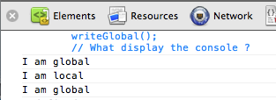
Variable scope
Functions & Scope
Be careful:
Variable declarations with var are always interpreted before the function execution

Slide 57
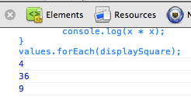
Function Expressions
Functions & Scope
JavaScript supports also function expressions
Functions with or without name (anonymous)
Can be used to contain functionality for short-term use
var values = [2, 6, 3];
var displaySquare = function(x) {
console.log(x * x);
}
values.forEach(displaySquare);

Slide 58
Functional
Functions & Scope
JavaScript is also a functional language !
First-class functions:
Can be assigned to variables or stored in data structures
Can be passed as arguments to other functions
Can be returned as the values from other functions

Slide 59
Fn expression VS Fn declaration
Functions & Scope
Function declarations are evaluated before any instructions in the same context
Function expressions are evaluated after all the instructions preceding it

Slide 60
Questions ?

Slide 61
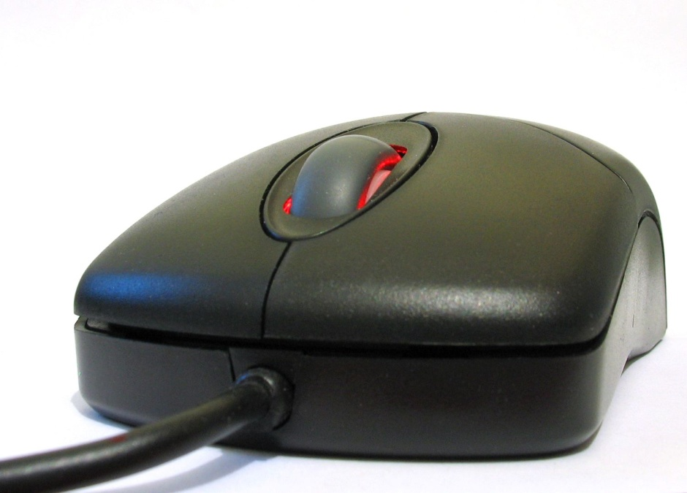
Events
Discover JavaScript language

Slide 62
Presentation
Events
When occurs:
User interaction
Action in the execution context
Properties of objects that depends on them
May call functions

Slide 63
Standard Event Attributes
Events
Start a treatment according to the actions of the user (click, mouse move, etc.)
Managed by the event Handler
HTML tag
that possesses events
Available event of the object
object
event
<input type="button" value="push me" onclick="alert('you click the button');"/>
Arguments
action
Available arguments of the object
Action associated to the event

Slide 64
Standard Event Attributes
Events
Event | Description
onLoad | Page is completely loaded
onUnload | Browser leaves current page
onClick | User clicks on an element
onDblclick | User double clicks on an element
onMouseover | Mouse flies over an element
onMouseout | Mouse leaves an element

Slide 65
Standard Event Attributes
Events
Event | Description
onFocus | An input field gets focus
onBlur | An input field loses focus
onChange | User modifies content of an input field
onSelect | User selects content of an input field
onSubmit | User submits a form

Slide 66
Questions ?

Slide 67
Exercises (1/2)
Events
You’re going to play with event handler!
Create a page containing only one HTML button
Create a new JS file
With two functions inside:
goToGoogle(): redirect the user to the google website
moveButton(): move the button inside the window without outpassing page bounds

Slide 68
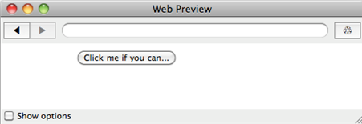
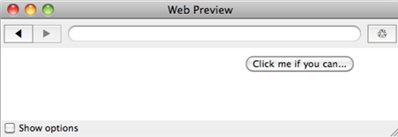
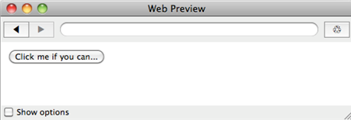
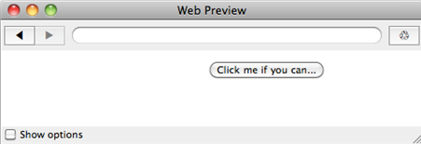
Exercises (2/2)
Events

Slide 69

DoM interactions
Discover JavaScript language

Slide 70
Introduction
DOM
Document Object Model
W3C Standard
Whole of standardized objects for HTML
Standardized tools to access and manipulate HTML documents
Independent of the language or the platform

Slide 71
Introduction
DOM
Simplified arborescence:
window
document
html
body
form
input
img

Slide 72
Access Elements
DOM
Access to all the structure of an HTML page
We will be able to dynamically:
Access HTML elements
Access, Modify and delete attributes and values
Create, modify and delete elements
Organize elements into a hierarchy

Slide 73
Access Elements
DOM
Access elements by their ID:
Return an unique element
Access elements by their name:
Return a JavaScript array containing all homonyms
document.getElementById(id);
document.getElementsByName(name);

Slide 74
Access Elements
DOM
Access elements by their tag name:
Return a JavaScript array containing all elements with the specified tag
document.getElementsByTagName(tagName);

Slide 75
Access Elements
DOM
Example:
<img id="img1" name="theImage" src="test.png" />
<script type="text/javascript">
var img = document.getElementById("img1");
var elements = document.getElementsByName("theImage");
console.log(elements[0] === img); // true
elements = document.getElementsByTagName("img");
console.log(elements[0] === img); // true
</script>

Slide 76
Access Elements
DOM
Access to all child nodes of an element:
Access to the parent node:
element.childNodes;
element.parentNode;

Slide 77
Manipulate Attributes
DOM
Access to the attributes of an element:
Modify the attributes of an element:
element.getAttribute("attribut");
element.setAttribute("attribut", "valeur");

Slide 78
Manipulate Values
DOM
Access to the text of an element:
Modify the text of an element:
element.firstChild.nodeValue;
element.firstChild.nodeValue = "texte";

Slide 79
Other manipulations…
DOM
Create an element
Modify the element
var e = document.createElement('p');
e.style.textAlign = 'center';

Slide 80
Other manipulations…
DOM
Add the element to the parent
Delete an element
parent.appendChild(e);
var e = document.getElementById("deleteMe");
e.parentNode.removeChild(e);

Slide 81
Other manipulations…
DOM
Add an element before an other one
element.parentNode.insertBefore(new_element,element);
Contender
new_element
element

Slide 82
<div id="content"> <h1>Hello world!</h1> <p> It’s my <strong>awesome</strong> page! </p>
</div>
<script type="text/javascript"> var divEl = document.getElementById("content");
var strongEl = divEl.childNodes[1].childNodes[1];
</script>
Accessing Elements

Slide 83
Questions ?

Slide 84
Exercise
DOM
You’re going to add JavaScript code to your contact form to validate user inputs!
Create a new JS file.
Declare a function named validateForm() which validate your form inputs
All fields have to be filled
Names must not contain numbers
E-mail format has to be validated with RegExp
Notes:
If a field contains error, set his color to red
Execute the function on form submit !

Slide 85

Introduction to object modeling
Discover JavaScript language

Slide 86
Presentation
Introduction to object modeling
JavaScript is an Object Oriented Programming language that uses Prototypes
We’ll see more about OOP next year but there are some basic concepts we have to see during this course…

Slide 87
Presentation
Introduction to object modeling
Objects in JavaScript are mutable keyed collections
number, string, boolean, null and undefined are primitive types
Arrays are objects

Slide 88
Presentation
Introduction to object modeling
An object contains properties
A property has a name and a value
A property name can be any string
A property value can be any JavaScript value
Strings
Arrays
Functions!
There are several ways to declare an object but we’re going to see just one during this course…

Slide 89
Object Literals
Introduction to object modeling
Convenient notation for creating new objects
A pair of curly braces surrounding zero or more name/value pairs:
var barney = {
"firstName": "Barney",
"lastName": "Stinson",
"saySmthg": function() {
console.log("It’s gonna be...");
}
}

Slide 90
Object Literals
Introduction to object modeling
Quotes around property names are optional if the name is a legal JavaScript name
Property values can be other object literals

Slide 91
Object Literals
Introduction to object modeling
Example:
var trip = {
departure: {
city: "Paris",
country: "France"
},
arrival: {
city: "Montreal",
country: "Canada"
},
price: 890
}

Slide 92
Object Literals
Introduction to object modeling
To access a property:
To call a method:
var firstName = barney.firstName;
var lastName = barney["lastName"];
barney.saySmthg();
barney.["saySmthg"]();

Slide 93
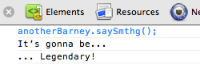
Object Literals
Introduction to object modeling
To create new instances based on an existing object, you can clone it:
var anotherBarney = Object.create(barney);
anotherBarney.saySmthg = function() {
console.log("... Legendary!");
};
barney.saySmthg();
anotherBarney.saySmthg();

Slide 94
The new operator
Introduction to object modeling
You can also in some specific case use the new operator to create new instances
We’ll see more about how to define objects with it in a next course…
var anArray = new Array(); // It works!
var newBarney = new barney(); // It doesn’t work because
// barney is an object literal

Slide 95
Standard objects
Introduction to object modeling
The main objects provide by the language are:
Type | Description
Array | Represent a data array
Math | Provide mathematics functions
Date | Represent a date
RegExp | A useful type to use regular expressions

Slide 96
Standard objects: Math
Introduction to object modeling
Math object
Properties: mathematical constants
Methods: mathematical functions
var nqpi = Math.round(Math.PI); // 3
var logE = Math.log(Math.E); // 1
var al = Math.random(); // ?
var al2 = Math.floor(Math.random() * 10);

Slide 97
Standard objects: Date
Introduction to object modeling
Date object
Represents a date/hour
Provide some useful functions
var now = new Date(); // today
var unix = new Date(0); // 1970-01-01
var date1 = new Date("Day Mth dd YYYY hh:mm:ss");
var date2 = new Date("YYYY","MM","DD","hh","mm","ss","ms");
var timestamp = Date.now();

Slide 98
Standard objects: RegExp
Introduction to object modeling
RegExp object
Allow to manipulate regular expressions
Can be created by two ways
Use modifiers:
"g" for "global"
"i" for "insensitive"
var regex = /PATTERN/<g|i|gi>;
regex = new RegExp("PATTERN",<"g"|"i"|"gi">);

Slide 99
Standard objects: RegExp
Introduction to object modeling
RegExp object:
Patterns also have functions:
test(str) to check if there is a match
exec(str) to return matched string parts
var str = "cdbBdbsbz”;
var re = /d(b+)(d)/ig;
var match = re.test(str);
console.log(match); // Display: « true »
var result = re.exec(str);
console.log(result.toString()); // Display: « dbBd,bB,d »

Slide 100
Questions ?

Slide 101

Clairvoyance!
Discover JavaScript language

Slide 102
Presentation
Clairvoyance
This interactive service will tell to people their magic number (between 0 and 9), from their firstname
You will also propose a service called "Love Meter" that will, from magic Numbers, find a compatibility level between a couple

Slide 103
Magic Number
Clairvoyance
To find the magic number, you will use the addition of products of each letter and a coefficient (index of the letter in the word) as shown in the next slide…

Slide 104
Magic Number
Clairvoyance
Example : Jim
j: 106^1 = 106 --> 1 + 0 + 6 = 7
i: 105^2 = 11025 --> 1 + 1 + 0 + 2 + 5 = 9
m: 109^3 = 1295029 --> 1 + 2 + 9 + 5 + 0 + 2 + 9 = 28
--> 2 + 8 = 10 --> 1 + 0 = 1
TOTAL : 7 + 9 + 1 = 17 → 1 + 7 = 8

Slide 105
Magic Number
Clairvoyance
To get the value of a letter, you have to use charCodeAt method on a string
Example : "tatito".charCodeAt(3);
-> gives 105
To proceed the operation 9 power 2 (9^2) in JavaScript, we use : Math.pow(9,2)

Slide 106
Magic Number
Clairvoyance
To calculate the compatibility, the user have to insert two names
Then find the magic number and compares it :
High : if the gap between the numbers is < 3
Medium : if the gap is between 3 and 6 (included)
Low : otherwise

Slide 107

Bonus
Clairvoyance
Add styles and colors to your webpage ;-)

Slide 108


